Slide 1

Optimization Solution Development Life Cycle: From Business Understanding to Deployment
Rob Randall, PhD – Senior Optimization Specialist
Irv Lustig, PhD – Optimization Principal
2023 INFORMS Business Analytics Conference
April 16, 2023

Slide 2






www.princeton.com
Information Technology & Management Consulting
Advanced Analytics
Strategy
Application Development
Process Improvement
2 Research Way
Princeton New Jersey
590 5th Ave
New York City
Transformation through AI and Optimization
Clients: Leading transportation and industrial supply chain organizations
Track Record: 42 years in business under founding leadership; Over 1800 successful completed projects
Experience: Senior Staff (top 28 consultants) average 15+ years; Firm Leadership (6 Directors) average 20+ years experience
Mission: Helping clients Accelerate their Digital Transformation

Slide 3

“Life-Altering” Improvements
“The increase in speed and flexibility from the new model impacts every piece of our business across multiple teams. Now we can strategically invest that time in everything from building more personal customer experiences to optimizing our production process. With this new model, Birchbox has truly entered a new operating universe.”
David Bendes
Vice President of Global Business Technology at Birchbox

Slide 4
Introduction
1. Determine Requirements
2. Develop Optimization Solution
3. Deploy Solution
4. Work with Clients to Ensure Adoption of Solution
Princeton Consultants has developed a process to deliver quality optimization tools that meet business users’ needs. This approach:
Focuses on understanding the current process and the decisions that are made by the users
Developing a tool/tools to help meet the needs of the users to help them make those decisions
Deploying solution in a way that allows the user to make these decisions at the rate that is needed
Working with the client to ensure the adoption of these tools

Slide 5
Determining the Right Problem to Solve
Interview Business Users
Development Business Requirements
Deliver Technical Requirements
Meet with users to understand the decisions they are making, why they’re making the decisions in this way, and how frequently they make decisions
This helps the team understand the business processes and determine the needs of the users
Take the information gathered during the interviews and work with stakeholders to determine the business requirements
Review those requirements with the users and stakeholders to build consensus
Take the business requirements and convert them to technical requirements
Review the technical requirements with the IT stake holders to ensure that the proposed solution meets IT requirements
Use those technical requirements to determine data needs and gaps
Princeton has a methodology that helps determine the problem that needs to be solved:
This approach builds understanding of the business
Engages business users and builds relationships
Leads to improved buy-in and investment from client

Slide 6



Example Project
A client, Aurora Inc, has brought us in to help them make better scheduling decisions
As part of the project, they make 2 of their 4 schedulers available to us to interview
They say the schedulers are very busy and 2 of the 4 schedulers should provide enough information for us

Slide 7
Example Project – User Interviews
Scheduler 1 - Jill
Each day brings in a new set of tasks that we need to assign to our workforce for them to complete for the day
Tasks for the day are in our data management system, as are the resources available to work this day
Labor rules provide a limit on how many hours each of our resources can work
We have groups of resources that must have a minimum number of tasks assigned to it per day, but we can’t overwork that specific group, so we don’t assign too many to them either
Need to get all the assignments done by 8 am for the day so that the resources can start work
Be able to review the resulting assignments to ensure they meet all of the rules
Scheduler 2 - José
Makes daily decisions about tasks to be scheduled today
Tasks have varying length, so we pay attention to that when assigning a task to a resource
Some tasks require special skills that not all our resources possess
Resources make different hourly rates so that must be taken into consideration when assigning work
Sometimes a resource gets bogged down on a task, so we need to be able to resolve and reassign the tasks that are not complete
We’re trying to build a schedule that costs the company the least amount of money

Slide 8

Example Project – Business Requirements
Tool needs to solve quickly and allow for re-solve with certain tasks locked in place
Present users a view of the resulting task assignments
The solution needs to minimize the cost of the assignments based on the resource specific costs of the assignment
The solution needs to prevent a resource from exceeding their maximum work hours
The solution needs to prevent assignments of tasks to resources who are not qualified to perform the task
The solution needs to ensure each resource group meets its minimum number of tasks for the day
The solution needs to ensure each resource group does not exceed its maximum number of tasks for the day
Allow for re-solves locking the assignments for tasks that have already been started

Slide 9
Technical Decisions
Now that we understand what the business needs from a tool and what features the tool must have, we will meet with the client’s IT department to ensure we meet their standards and tools they use
This meeting will also lay the groundwork for data acquisition so that we can understand the state of the data feeding the model
From this meeting we will develop the technical requirements for the project

Slide 10
Example Project – IT Requirements
Back End
They use python or java for their backend code
They have a licensing agreement with Gurobi if we use a MIP
They are ok with Flask RESTful services
Now we’re going to meet with the chief architect to discuss the technical needs of the project
This will go a long way in determine how the project goes
If the tech stack is not amenable to data feeds and modeling it will make the project significantly more difficult
Front End
Their UI preference is Java swing
They will build the screen that lets the user see the results of the model
They are ok with us building a test UI to show the users the results in our choice of languages
Data Feed
They do not currently have a data feed to their task and resource information
They will build it and deliver it as part of the project
For initial testing the tool will have to be able to read in data
We specify that the data should be in a tabular format, such as Excel (more on that in a bit)
Talk with them about plans to start collecting and saving historic data so the team can use it for testing.

Slide 11
Example Project – Technical Requirements
Backend
The tool will be built in python
The server will be accessible via web services and running as a Flask application
Any MIP/LP models will be built using the gurobipy library
Frontend
Users will have access to the tool via a web page
The tool will be built using the Angular JavaScript framework
The tool will allow for XLSX data loading of task and resource data
The tool will display scheduling results to allow users to test the model
Data Feed
The tool will access a yet to be built web service to access the task and resource data
The tool will have a web service end point that allows access to the model results including the schedule and any resulting statistics

Slide 12
Refresher on Steps Done So Far
User Interviews
Meet with a representative set of business users
Generally, the more the better, but there is a point where you hit diminishing returns
Use the interviews to understand how they work now and what decisions they make
Those decisions will help drive the business requirements
Business Requirements
Extract the items that are necessary for any tool being built to meet the needs of the business from the interviews
Provide the requirements back to the business stakeholders to get approval
Once we know what the tool needs to do we start talking about how the tool is going to achieve them
Technical Discussions
Meet with technical stakeholders, often an architect in the IT group, to determine the technical capabilities of the client
They will generally also have a preferred technological stack they use (e.g. CPLEX or Gurobi or FICO Xpress, Java, Angular or React, Oracle or MySQL or postgres, Azure or AWS or Google Cloud, Python) and the team will need to use those tools to deliver the project
After learning about the technical tools, we can write up a set of technical requirements
Technical Requirements
Deliver the technical requirements of the project to the stakeholders to ensure agreement on how things will be delivered
This ensures that we at least know what technical stumbling blocks that will likely come up over the course of the project
And potentially help us plan certain items that may be needed to mitigate those issues

Slide 13
Technical Solution Implementation
Data + Model → Solution

Slide 14
Model Development
1. Understand the Data
2. Define and Document Datasets
3. Collect Data from the Client
4. Document Data Transformations
5. Create Model Documentation
6. Code Optimization Model
7. Validate Results and Iterate
At this point in the project, we start a 7-step approach that we believe improve the likelihood of success in optimization projects. This approach:
Creates useful documentation
Shortens the overall development time
Improve code maintainability
Provides a natural feedback loop to business requirements

Slide 15
Introduction
The preferred tools used in the development are python with the pandas library
Python has a rich ecosystem which aids in deployment
Pandas provides a very clean, sparse way of containing and manipulating the data
This is often used in concert with Gurobi’s python interface (gurobipy)
Also used with other python APIs
IBM ILOG CPLEX (docplex),
FICO Xpress-MP (xpress)
Google’s OR Tools (ortools)
Successfully applied to multiple clients and verticals

Slide 16
1. Understand the Data
2. Define and Document Datasets
3. Collect Data from the Client
4. Document Data Transformations
5. Create Model Documentation
6. Code Optimization Model
7. Validate Results and Iterate

Slide 17
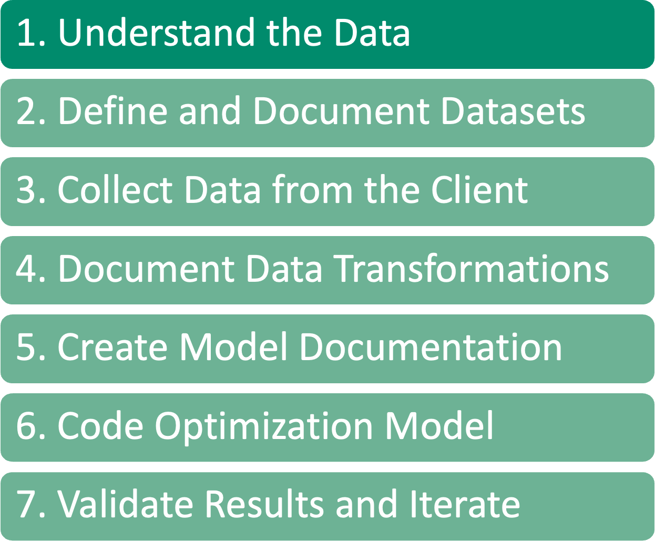
Understand the Data
Understanding the data required is an ABSOLUTE NECESSITY for an optimization project to be successful
For this step work with your clients to understand:
This is the MOST IMPORTANT step in an optimization project, because without a deep understanding of the data available for optimization, we cannot build a good model
What data is available
The semantic meaning of that data
How they organize that data
How different pieces of data are related to each other

Slide 18
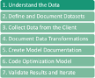
Determining the Available Data
How many times have you (or seen some one who has) built a model, probably a beautiful, elegant model, only to find out that half of the data that you planned to use doesn’t exist?
That’s why before we ever start modeling, we work with our clients to determine what data they have and what state that data is in
Sometime there may be data, but it may be incomplete or inaccurate
This is a key step in determining what type of model can be built

Slide 19
The semantic meaning of that data
Are there universally agreed upon names for data fields?
In my experience there is not, so while one company might call a piece of data X, for another that may be Y, and X may be something entirely different.
Transit time is a good example
Another issue can be mismatched units
Column may be named Minutes but the data is saved in Seconds
Therefore, not only do we work with our clients to determine what data is available to model, but to make sure we know what each piece of data means and how it was created.
This generally involves creating a data dictionary so that we have definitions of what each table and each field in those tables represent
This is a good practice for the client to get into as well, as often with turnover there are fields that the client isn’t even always sure the meaning of

Slide 20
How different pieces of data are related to each other
Not only do we need to know how each piece of data is defined but need to know how the different pieces of data work together.
Determine relationships and other linking pieces that can be used when building the model
Some of these may determine what variables you can use
And what constraints may need to be built on those relationships

Slide 21
1. Understand the Data
2. Define and Document Datasets
3. Collect Data from the Client
4. Document Data Transformations
5. Create Model Documentation
6. Code Optimization Model
7. Validate Results and Iterate

Slide 22
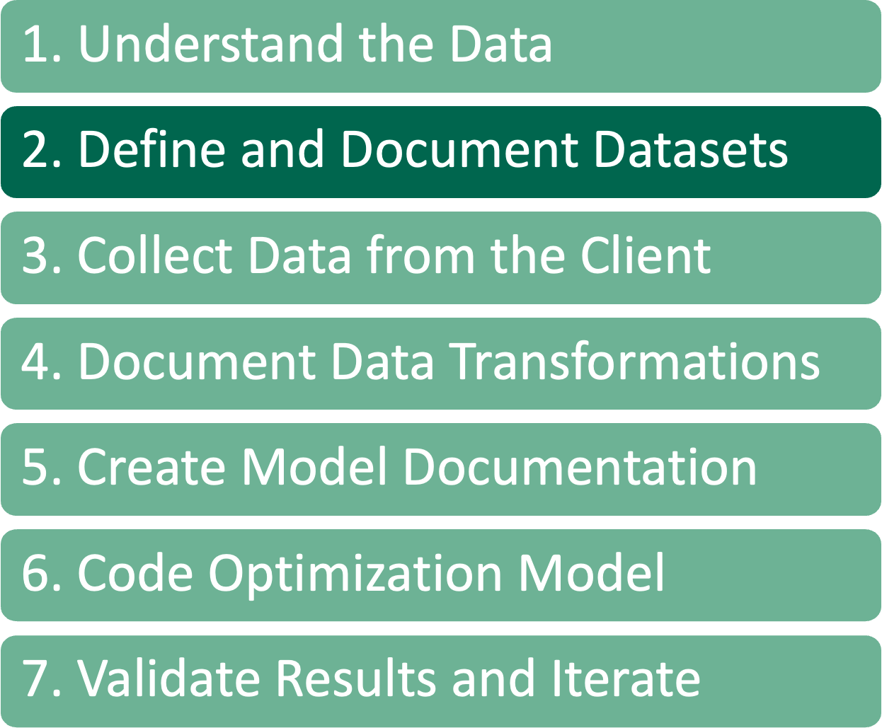
Define and Document Datasets
A format needs to be defined for the client to deliver the datasets in a consistent and meaningful format to the team
We generally use the concept of “tidy data” as a starting point for this format
Columns contain variables, rows contain observations
When creating these definitions, we define mathematical notation to represent the data items
Use Markdown where we can include LaTeX notation.
This is generally done in either Visual Studio Code or a Jupyter Notebook
Can export using Pandoc to a distributable (doc, pdf) form
This document is often reviewed with the client

Slide 23
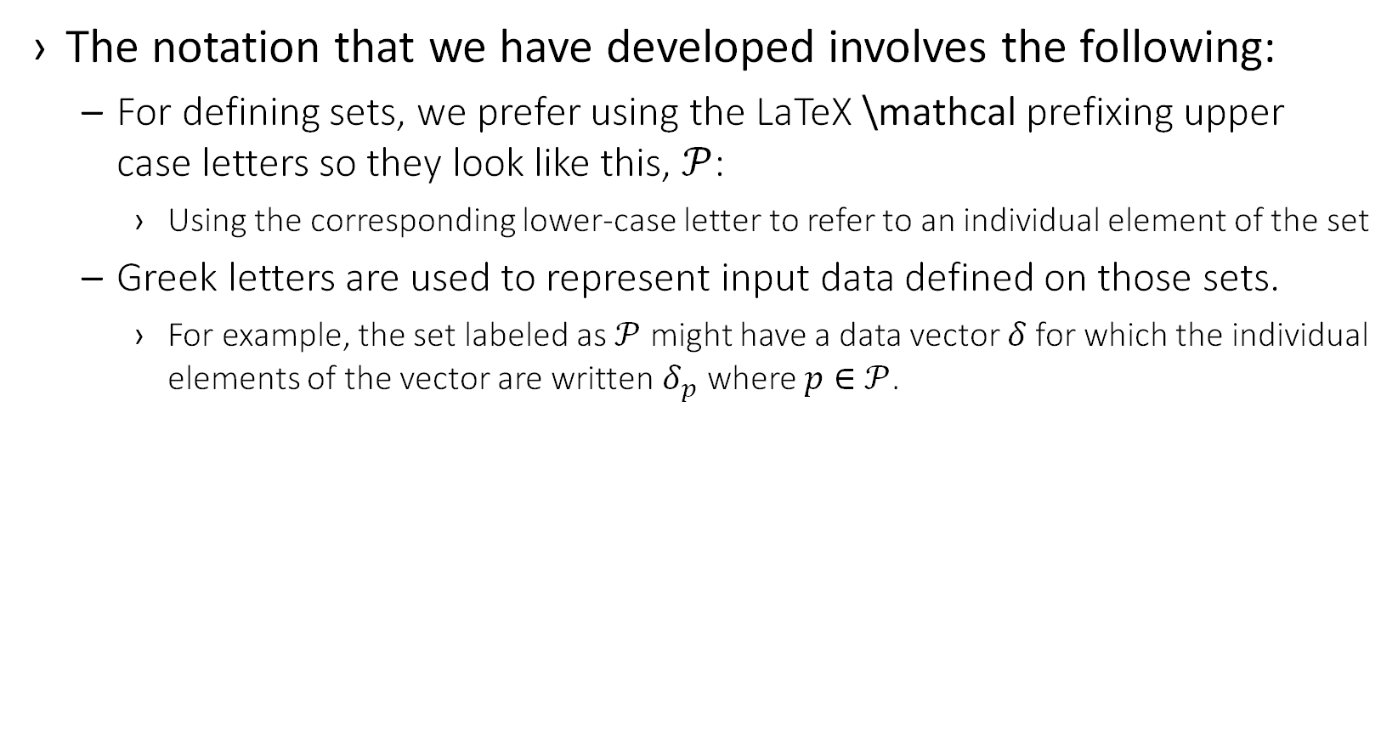
Define and Document Datasets
The notation that we have developed involves the following:
For defining sets, we prefer using the LaTeX \mathcal prefixing upper case letters so they look like this, $𝒫$:
Using the corresponding lower-case letter to refer to an individual element of the set
Greek letters are used to represent input data defined on those sets.
For example, the set labeled as $𝒫$ might have a data vector $δ$for which the individual elements of the vector are written $δ_{p}$ where $p∈$ $𝒫$.

Slide 24
Example Problem
Back to our example from Aurora, Inc. Remember our model specific requirements
There are a set of tasks to be scheduled
There are a set of resources to schedule the tasks
Tasks have different processing times
There are groups of resources
Each resource has a maximum length of time they can actively work on tasks
A resource has a specific operating cost per time unit
Some tasks cannot be completed by some resources
Each resource group has a minimum and a maximum number of tasks in a day
The goal is to minimize the total cost of processing all the tasks

Slide 25
Example – Data Table Documentation
Table
Column
There are a set of tasks to be scheduled
Tasks have different processing times
Tasks
Task – The unique identifier for the task
Time – The task duration, in hours
There are groups of resources
Each resource group has a minimum and a maximum number of tasks that they need to do in a day
ResourceGroups
ResourceGroup – The unique identifier for the resource group
MinTasks – The minimum number of tasks this resource group can perform in a day
MaxTasks – The maximum number of tasks this resource group can perform in a day
A Resource has a specific operating cost per time unit
Resources
Resource – The unique identifier for the resource
There are a set of resources to schedule the tasks
Each resource has a maximum length of time that they can be actively working on tasks
HoursAvailable – The number of hours this resource can be used in a day
CostPerHour – The cost, in dollars, per hour for using this resource
TaskResource
Task – A reference to a Task instance
Some tasks cannot be completed by some resources
The goal is to minimize the total cost of processing all the tasks
Resource – A reference to a Resource that can perform this Task
This is a calculated data transformation, which we’ll talk about later
Cost – The cost to assign a task to a resource

Slide 26
Example – Model Data Documentation
Sets
Let $𝒯$ be the set of tasks that need to be completed.
Tasks table, Task column
Let $𝒢$ be the set of resource groups.
ResourceGroups table, ResourceGroup column
Let $ℛ$ be the set of resources that can complete the tasks.
Resource table, Resource column
Let $𝒬_{r}$ be the set of tasks that resource $r∈ℛ$ can perform.
All values of the Task column in the TaskResource table that have Resource r
Let$𝒫_{t}$ be the resources that task $t∈𝒯$can be scheduled on.
All values of the Resource column in the TaskResource table that have Task t
Let $𝒮_{g}$ be the resources that belong to resource group $g∈𝒢$.
Resource table, ResourceGroup column

Slide 27
Example – Model Data Documentation
Data Inputs
Let $η_{t}>0$ be the number of hours for a task $t∈𝒯$.
Task table, Time column
Let $λ_{r}≥0$ be the cost per hour for a resource $r∈ℛ$.
Resource table, CostPerHour column
Let $γ_{r}≥0$ be the number of hours that a resource $r∈ℛ$ can work in one day.
Resource table, HoursAvailable column
Let $α_{g}≥0$ be the min number of tasks, $t∈𝒯$, that resource group $g∈𝒢$ can work.
ResourceGroup table, MinTasks column
Let $β_{g}≥0$ be the max number of tasks, $t∈𝒯$, that a resource group$g∈𝒢$ can work.
ResourceGroup table, MaxTasks column

Slide 28
1. Understand the Data
2. Define and Document Datasets
3. Collect Data from the Client
4. Document Data Transformations
5. Create Model Documentation
6. Code Optimization Model
7. Validate Results and Iterate

Slide 29

Define and Document Datasets
Generally, comes in one of two ways
Client just dumps their data to us
Work with client to determine our data needs and specify what data to send and the format for that data
All data should be in a tabular format
CSV
Excel with multiple sheets

Slide 30
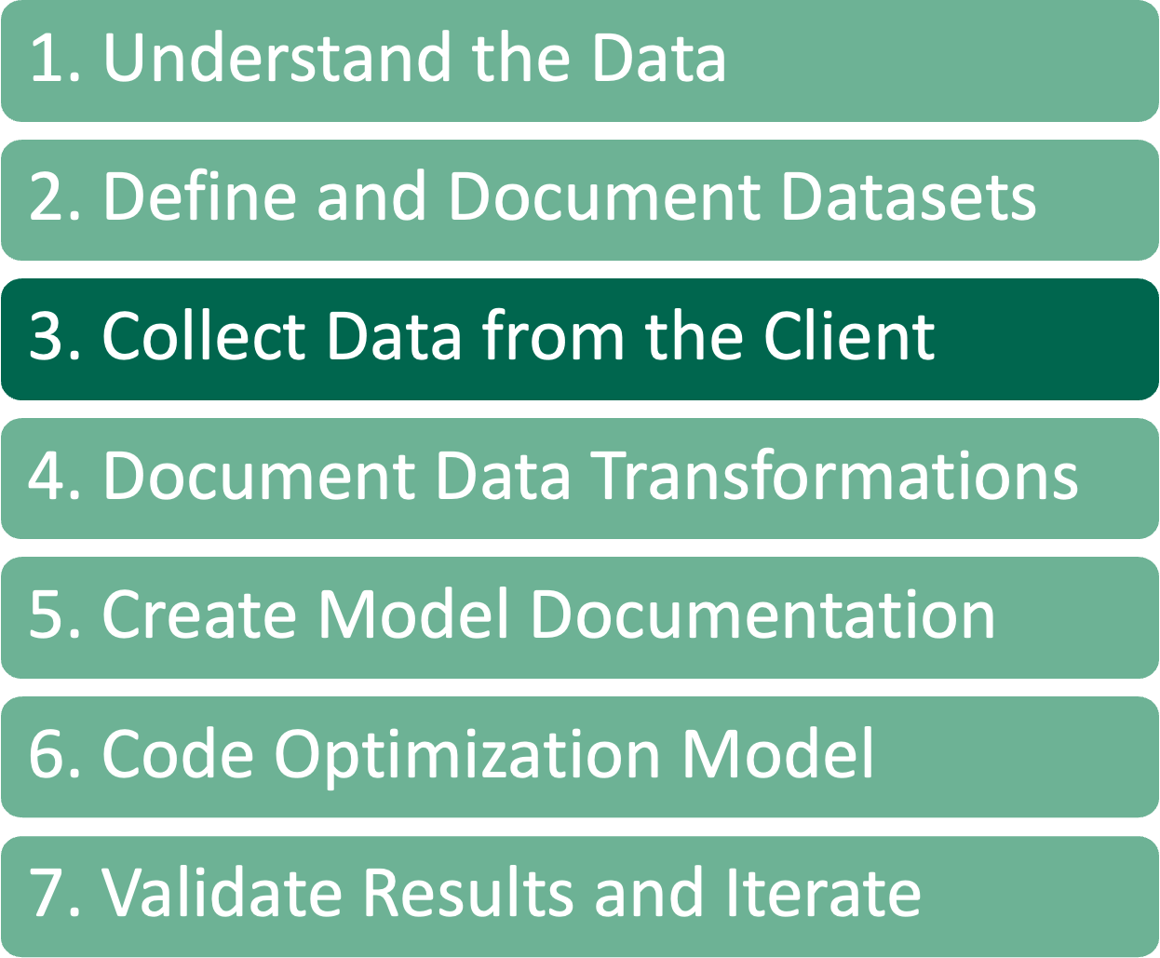
Client Data Dump
When the client dumps data to us, we refer to that as the “raw data format”.
Production data
Not necessarily model friendly
Using Python and Pandas, transform this data to a format that’s model friendly, the “model data format”
Calendar dates transformed to discrete periods
Dropping unnecessary data
Combining multiple production tables into data tables we’ve defined

Slide 31
Use Created Data Tables
Client uses the data tables we create to feed data to us
This is the best way for us, which means it almost never happens
Cuts down on the data passed and work we do, since the data matches our tables
Still may need some processing
Calendar to discrete periods

Slide 32
Collect Data From the Client
As we work on this code, sometimes we must update our documentation of the tidy data format that we are expecting
This is a living document
Update based on new understanding
When new data is added for features
Once the input data to the model has been defined there should be some data validation tests added.
This will help prevent data issues that pop up in production and “break” the model.
Not going to catch them all
Continue refining throughout project

Slide 33
Example – Data Validations
What are some validations that should be added for this model?
Do this in terms of data definitions, doesn’t have to be an optimization person who codes this
Ensure no task takes longer than a resource can work
Ensure every task can be done by at least one resource
The total resource hours available exceeds the total task work hours required
Ensure there are enough tasks that can be assigned to resources in each resource group to meet the minimum number of tasks for that group
Ensure that the total number of tasks that can be performed by all resource groups exceed the number of input tasks

Slide 34
1. Understand the Data
2. Define and Document Datasets
3. Collect Data from the Client
4. Document Data Transformations
5. Create Model Documentation
6. Code Optimization Model
7. Validate Results and Iterate

Slide 35
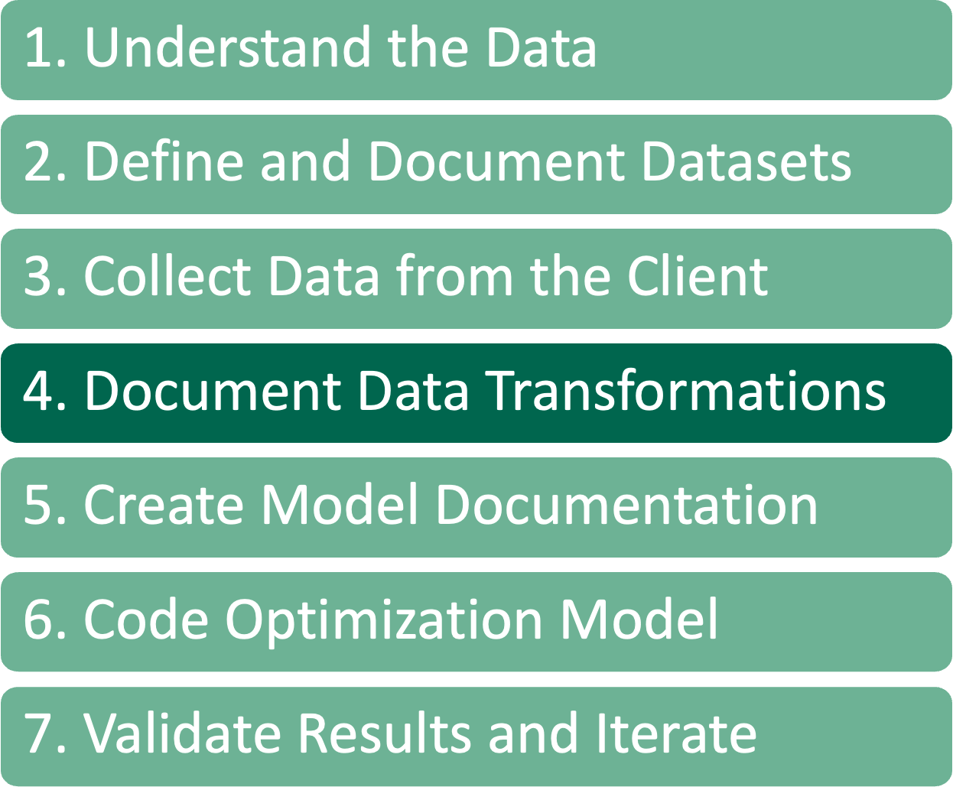
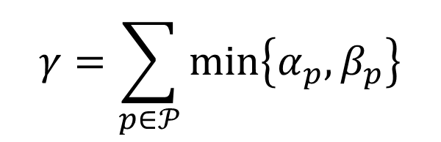
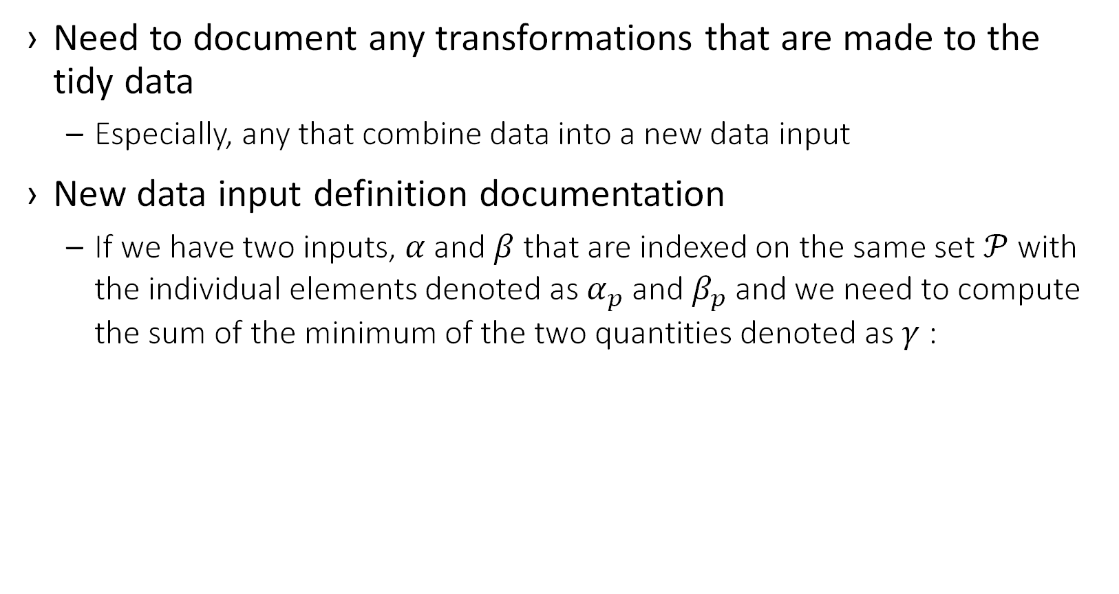
Document Data Transformations
Need to document any transformations that are made to the tidy data
Especially, any that combine data into a new data input
New data input definition documentation
If we have two inputs, $α$ and $β$ that are indexed on the same set $𝒫$ with the individual elements denoted as $α_{p}$ and $β_{p}$ and we need to compute the sum of the minimum of the two quantities denoted as $γ$ :
$$γ=\sum_{p∈𝒫}{min⁡\left\{α_{p},β_{p}\right\}}$$

Slide 36
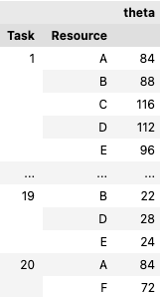
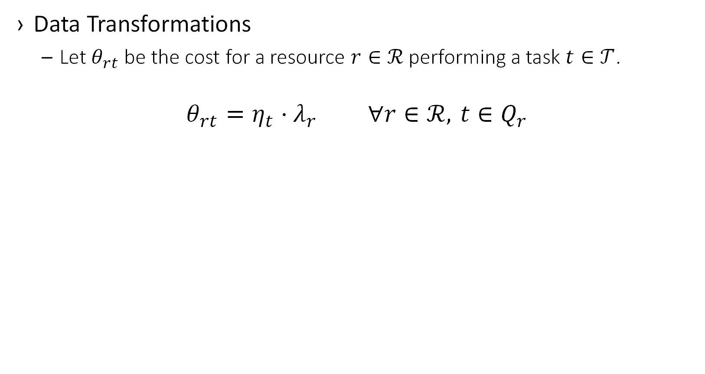
Example
Data Transformations
Let $θ_{rt}$ be the cost for a resource $r∈ℛ$ performing a task $t∈𝒯$.
$$θ_{rt}=η_{t}⋅λ_{r} ∀r∈ℛ, t∈Q_{r}$$
Task | Resource
1 | A
1 | B
1 | C
1 | D
1 | E
2 | D
2 | E
2 | F
3 | E
4 | A
4 | B
4 | C
4 | D
5 | B
Task | Time
1 | 2
2 | 3
3 | 2
4 | 3
Resource | Cost
A | 29
B | 26
C | 25
D | 26
E | 17
F | 22

Slide 37
1. Understand the Data
2. Define and Document Datasets
3. Collect Data from the Client
4. Document Data Transformations
5. Create Model Documentation
6. Code Optimization Model
7. Validate Results and Iterate

Slide 38
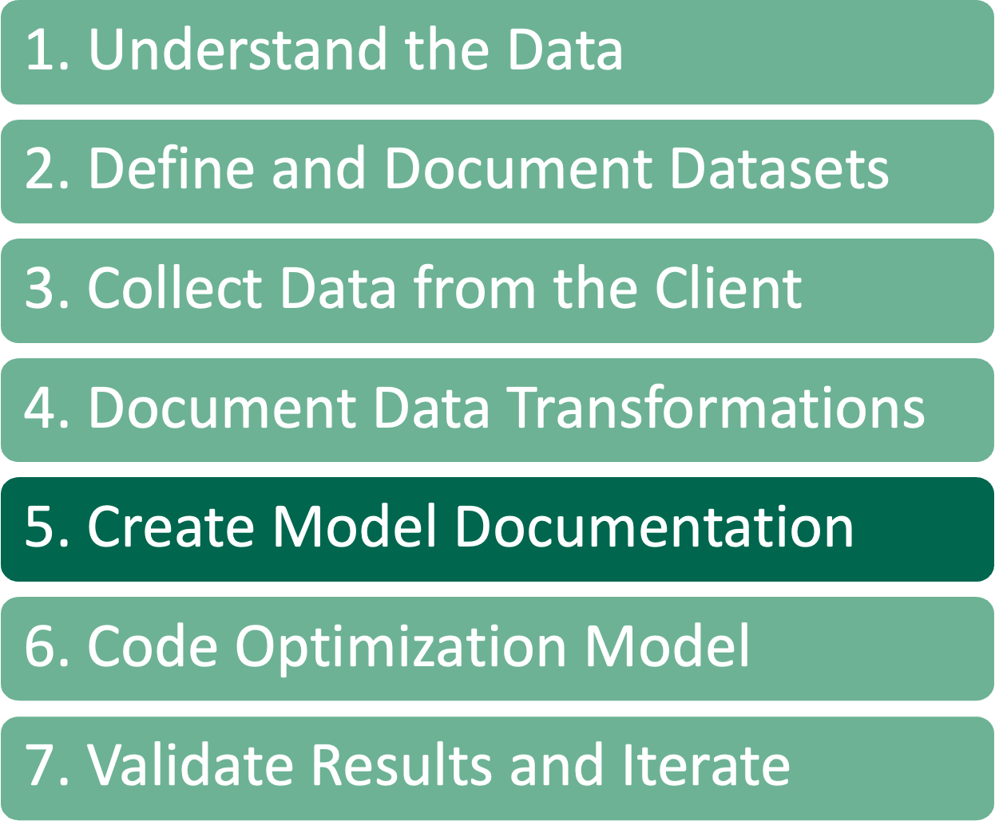
Create Model Documentation
Now that the data inputs and transformations are documented, we can write a document that describes the optimization model that we will build. This includes:
Decision variables
Our convention is to use a single lower-case English letter for a decision variable
The sets that describe these variables are listed using subscripts
Constraints
Add constraints to the model one at a time to allow for constant model testing
Objective function(s)
A multi-objective model, or
Allow users to choose from multiple objectives

Slide 39
Create Model Documentation
Each item is also described in “Plain English” to ensure an understanding of what the model is trying to accomplish
Auditability
Show understanding of rules to business
Create an Optimization Business Logic Document, that is shared specifically with business users
Used to create a solution checker

Slide 40
Example Problem
Let’s go back to our example.
There are a set of tasks to be scheduled
There are a set of resources to schedule the tasks
Tasks have different processing times
There are groups of resources
Each resource has a maximum length of time they can actively work on tasks
A resource has a specific operating cost per time unit
Some tasks cannot be completed by some resources
Each resource group has a minimum and a maximum number of tasks in a day
The goal is to minimize the total cost of processing all the tasks

Slide 41
Example Problem
Let’s try and characterize the requirements.
Decisions
Assign tasks to resources
Determine the number of tasks scheduled on a group of resources
Rules
Each task must be scheduled
Each resource has a maximum length of time they can be actively working on tasks
Each resource group has a minimum and a maximum number of tasks that they need to do in a day
Goals
Minimize the total cost of processing all the tasks

Slide 42
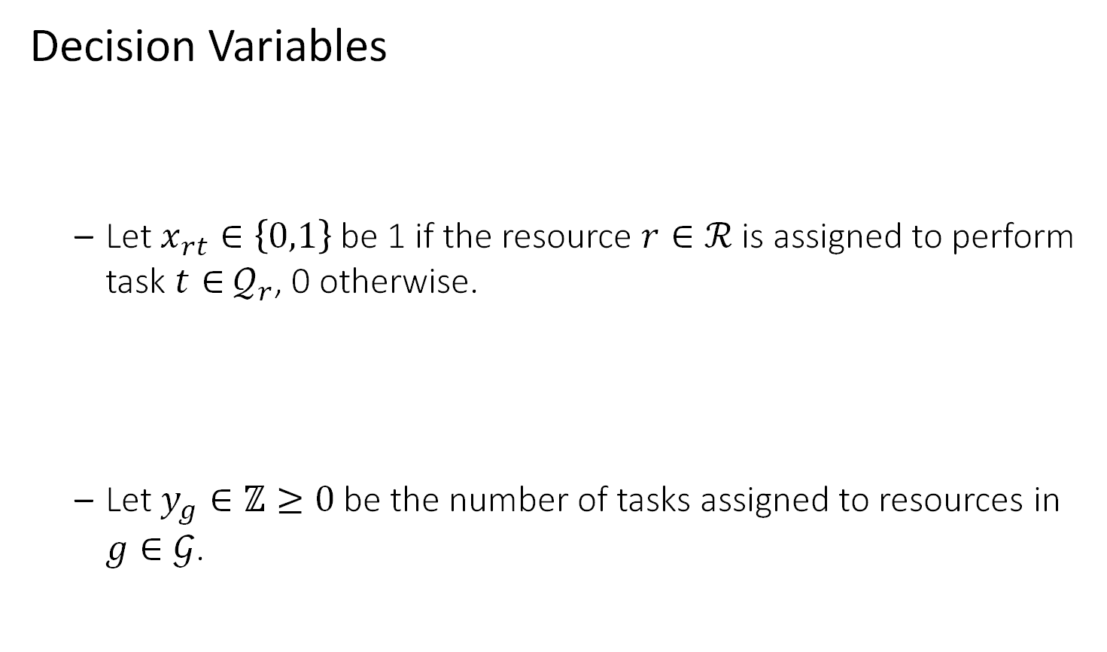
Example – Model Documentation
Decision Variables
Let $x_{rt}∈\left\{0,1\right\}$ be 1 if the resource $r∈ℛ$ is assigned to perform task $t∈$ $𝒬_{r}$, 0 otherwise.
Let $y_{g}∈ℤ≥0$ be the number of tasks assigned to resources in $g∈𝒢$.
There are a set of tasks to be scheduled on a set of resources
Determine the number of tasks scheduled by a group of resources

Slide 43
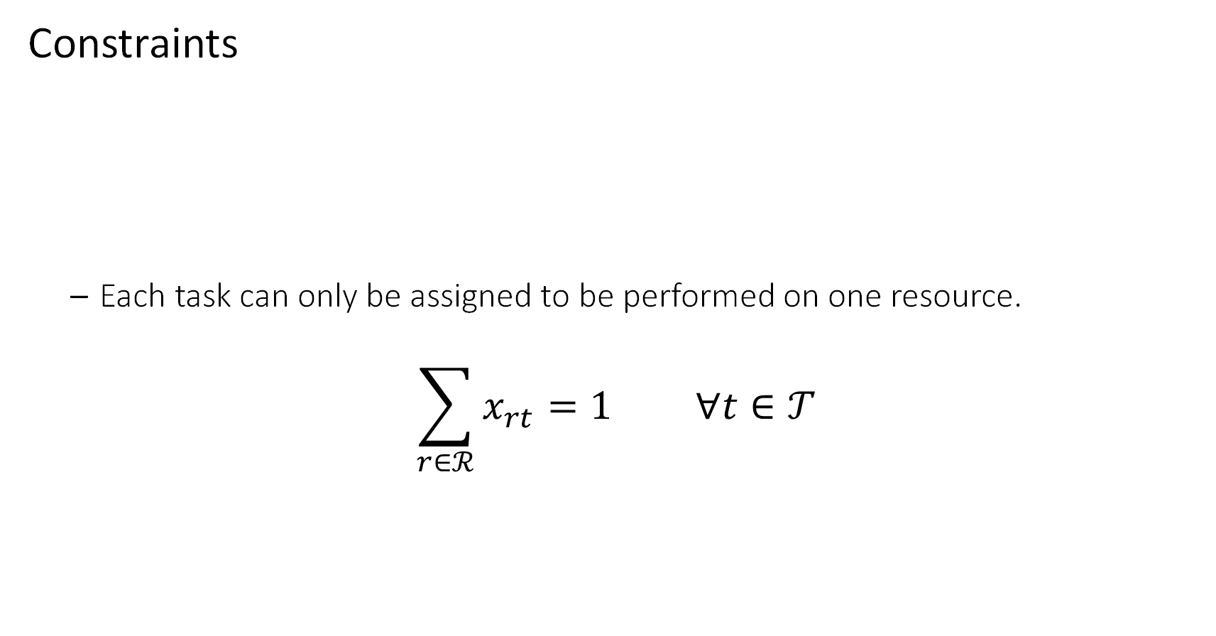
Example – Model Documentation
Constraints
Each task can only be assigned to be performed on one resource.
$$\sum_{r∈ℛ}^{​}{x_{rt}}=1 ∀t∈𝒯$$
Each task must be scheduled

Slide 44
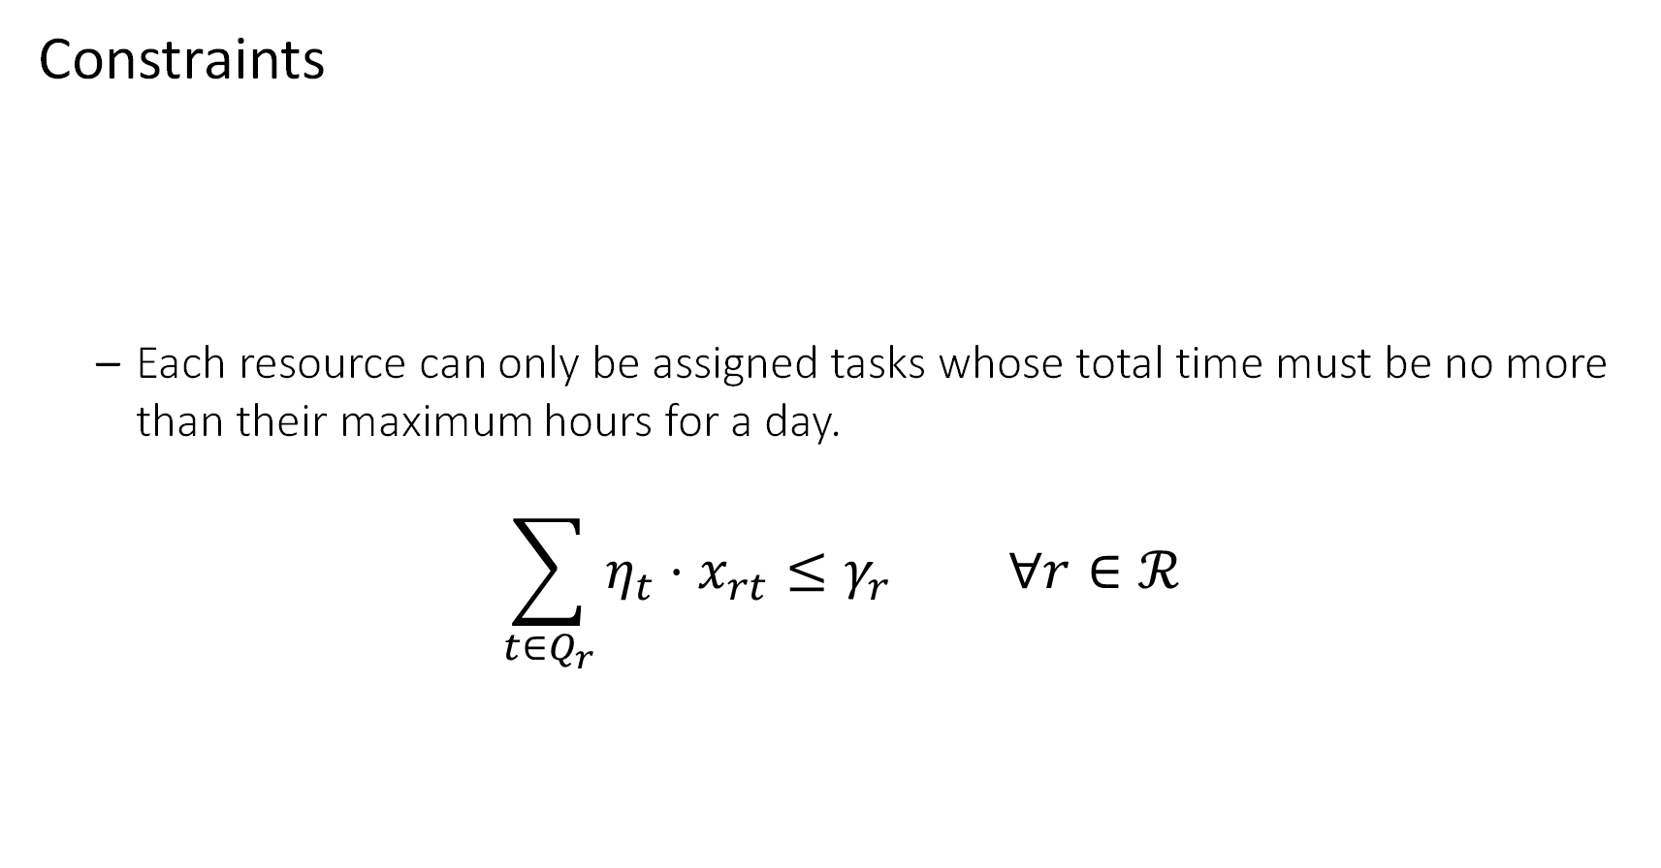
Example – Model Documentation
Constraints
Each resource can only be assigned tasks whose total time must be no more than their maximum hours for a day.
$$\sum_{t∈Q_{r}}^{​}{η_{t}}⋅x_{rt}≤γ_{r} ∀r∈ℛ$$
Each resource has a maximum length of time they can be actively working on tasks

Slide 45
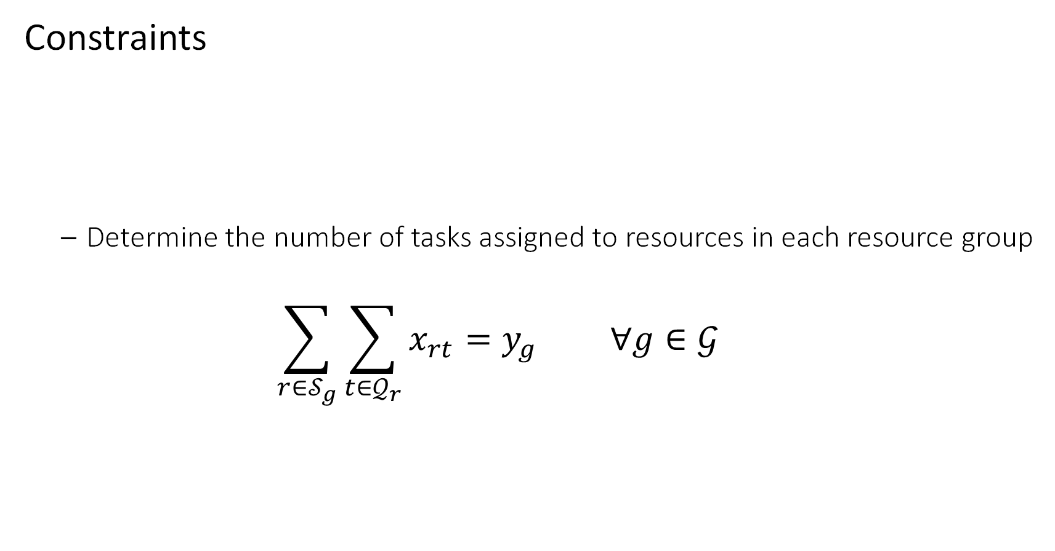
Example – Model Documentation
Constraints
Determine the number of tasks assigned to resources in each resource group
$$\sum_{r∈𝒮_{g}}^{​}{\sum_{t∈𝒬_{r}}^{​}{x_{rt}}}=y_{g} ∀g∈𝒢$$
Each resource group has a minimum and a maximum number of tasks that they need to do in a day

Slide 46
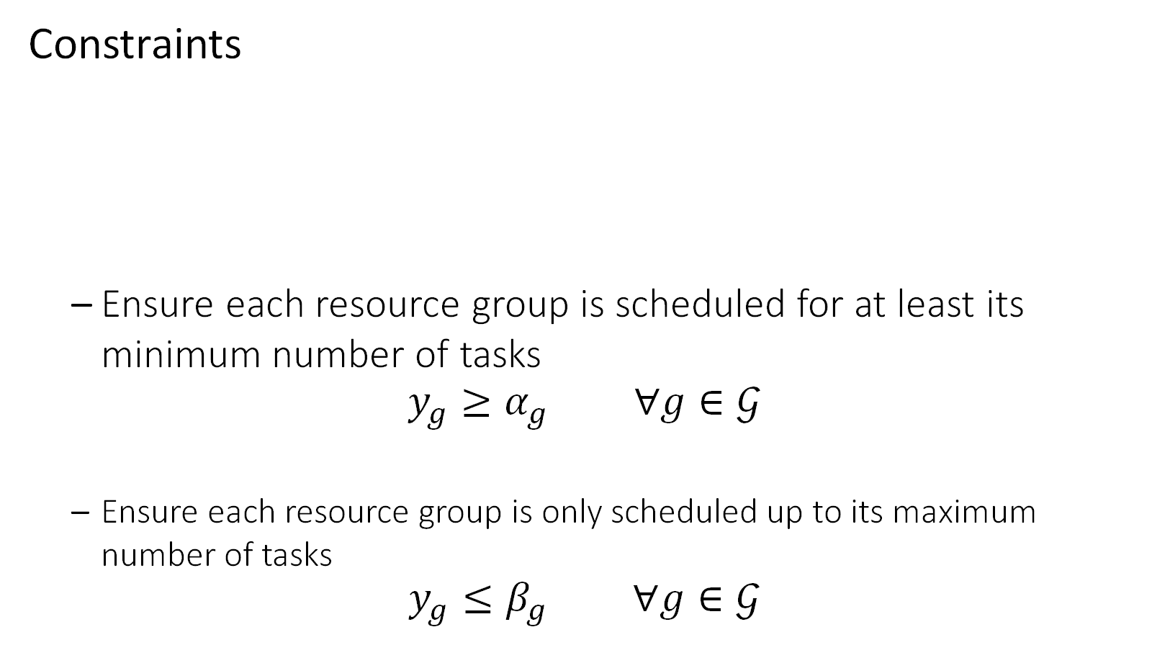
Example – Model Documentation
Constraints
Ensure each resource group is scheduled for at least its minimum number of tasks
$$y_{g}≥α_{g} ∀g∈𝒢$$
Ensure each resource group is only scheduled up to its maximum number of tasks
$$y_{g}≤β_{g} ∀g∈𝒢$$
Each resource group has a minimum and a maximum number of tasks that they need to do in a day

Slide 47
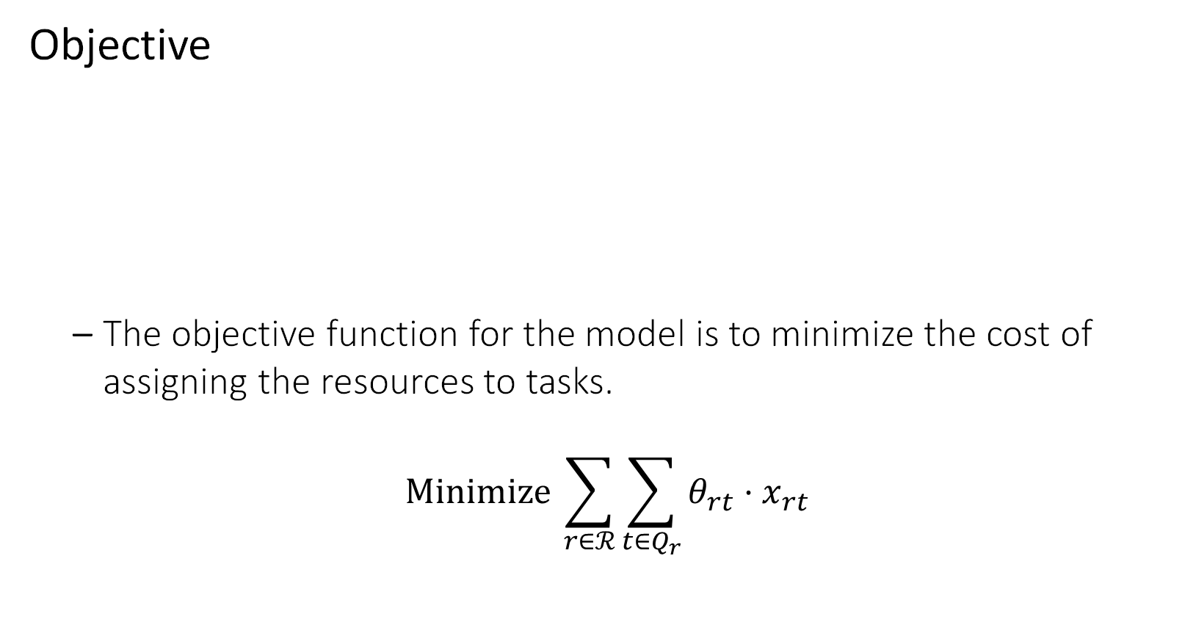
Example – Model Documentation
Objective
The objective function for the model is to minimize the cost of assigning the resources to tasks.
$$Minimize \sum_{r∈ℛ}^{​}{\sum_{t∈Q_{r}}^{​}{θ_{rt}}}⋅x_{rt}$$
Minimize the total cost of processing all the tasks

Slide 48
1. Understand the Data
2. Define and Document Datasets
3. Collect Data from the Client
4. Document Data Transformations
5. Create Model Documentation
6. Code Optimization Model
7. Validate Results and Iterate

Slide 49
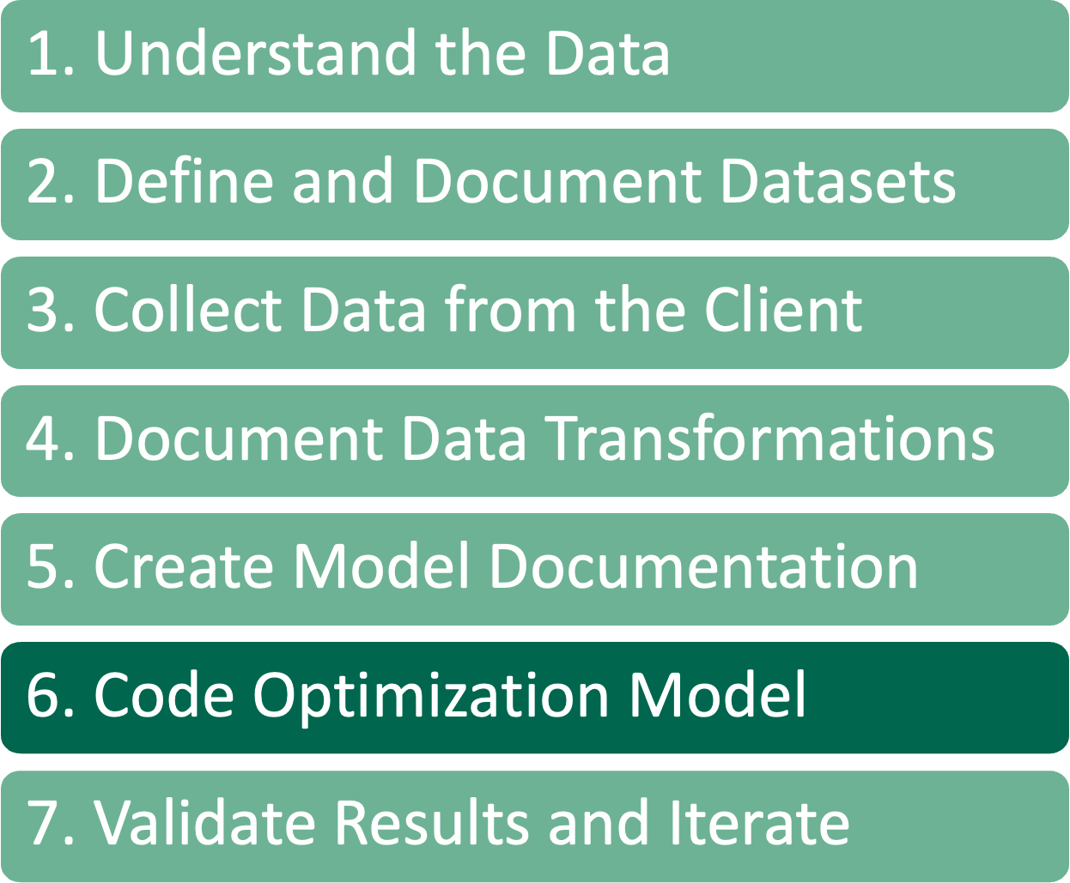
Code Optimization Model
Data inputs and transformations are documented, created a formulation that we believe solves the problem for the client
Now we FINALLY start writing code for the model.
For complicated models, often start with a prototype in a Jupyter Notebook
This allows for rapid testing to ensure that the model is built correctly
Then we can take the prototype and convert it into a class object that can be integrated into whatever system we’re building
Add a single constraint at a time, continuously testing the model
Often, we use a RESTful service endpoint that receives data for an instance of the model
Model can be created and tested without the service
Allows for more parallel development
This is a wrapper that takes data in and passes that data to the model code
Believe in separating the model code from the service
See Irv’s talk on Tuesday at 9AM for a description of how this works

Slide 50
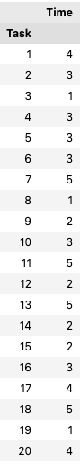
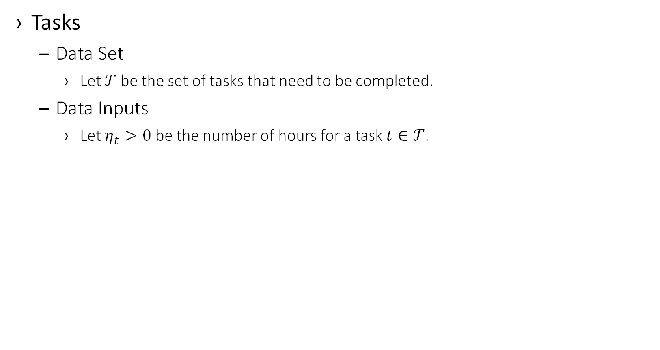
Example – Code Optimization Model
Tasks
Data Set
Let $𝒯$ be the set of tasks that need to be completed.
Data Inputs
Let $η_{t}>0$ be the number of hours for a task $t∈𝒯$.
tasks = pd.read_excel("../data/data.xlsx",
sheet_name="Tasks",
index_col=0)

Slide 51
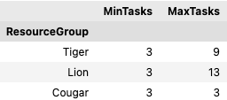
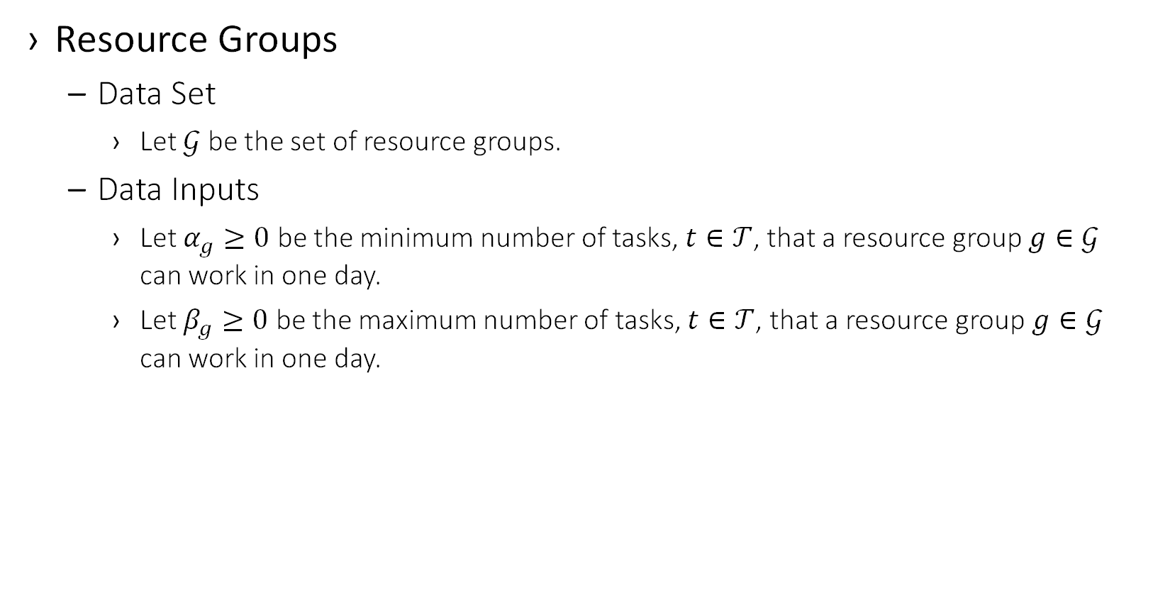
Example – Code Optimization Model
Resource Groups
Data Set
Let $𝒢$ be the set of resource groups.
Data Inputs
Let $α_{g}≥0$ be the minimum number of tasks, $t∈𝒯$, that a resource group $g∈𝒢$ can work in one day.
Let $β_{g}≥0$ be the maximum number of tasks, $t∈𝒯$, that a resource group$g∈𝒢$ can work in one day.
resource_groups = pd.read_excel("../data/data.xlsx",
sheet_name='Resource Groups’,
index_col=0)

Slide 52
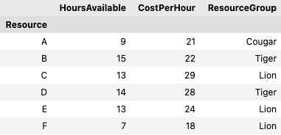
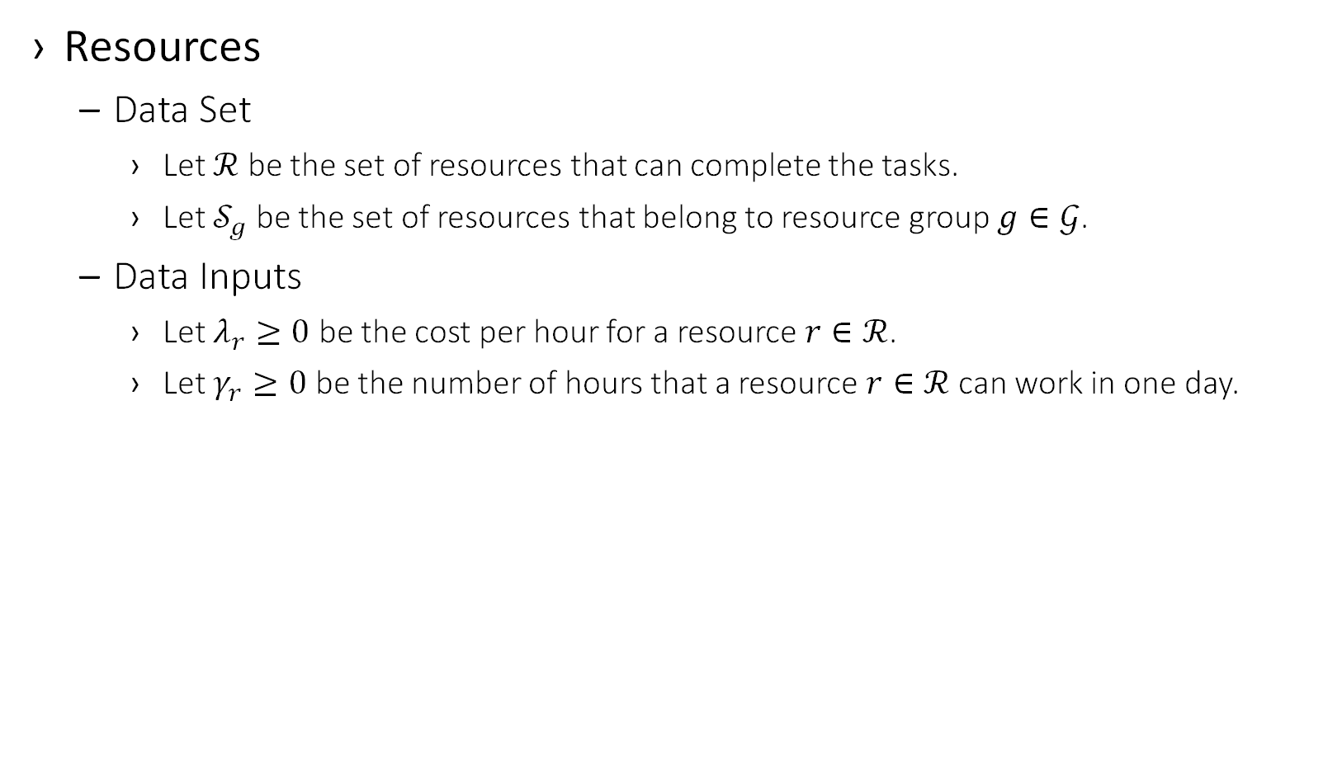
Example – Code Optimization Model
Resources
Data Set
Let $ℛ$ be the set of resources that can complete the tasks.
Let $𝒮_{g}$ be the set of resources that belong to resource group $g∈𝒢$.
Data Inputs
Let $λ_{r}≥0$ be the cost per hour for a resource $r∈ℛ$.
Let $γ_{r}≥0$ be the number of hours that a resource $r∈ℛ$ can work in one day.
resources = pd.read_excel("../data/data.xlsx",
sheet_name='Resources’,
index_col=0)

Slide 53
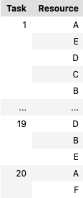
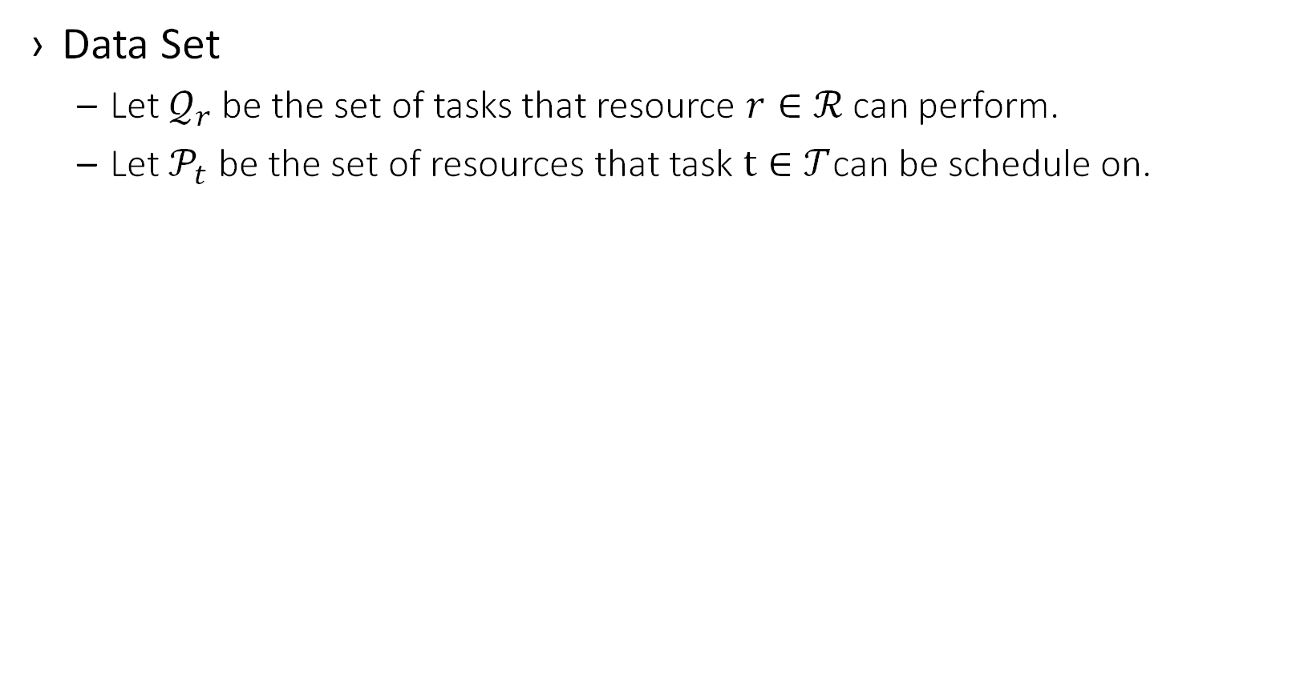
Example – Code Optimization Model
Data Set
Let $𝒬_{r}$ be the set of tasks that resource $r∈ℛ$ can perform.
Let$𝒫_{t}$ be the set of resources that task $t∈𝒯$can be schedule on.
res_task = pd.read_excel("../data/data.xlsx”,
sheet_name='Tasks For Resources’,
index_col=[0,1])

Slide 54
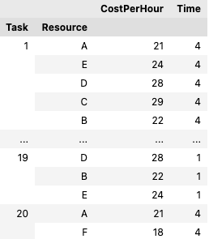
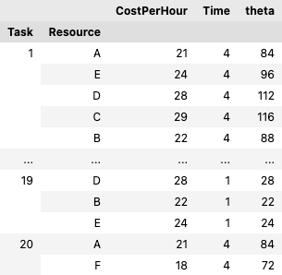
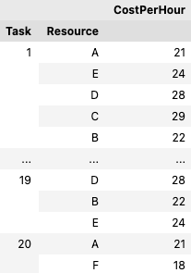
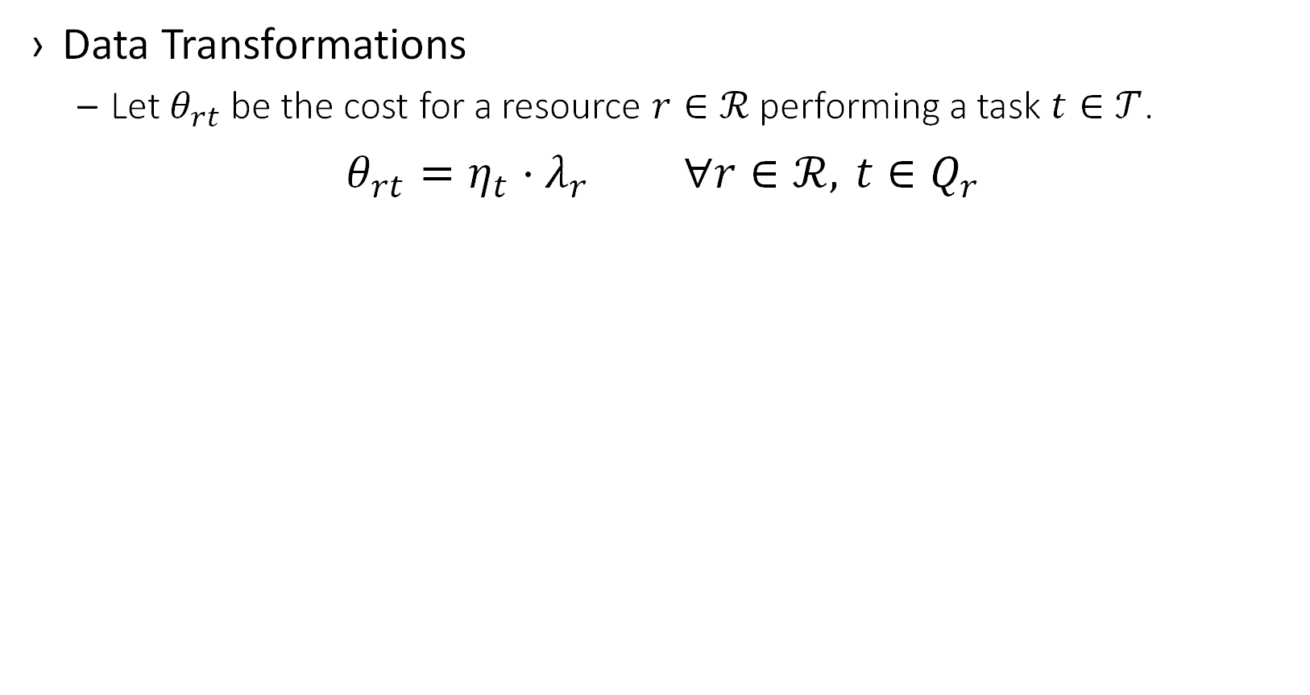
Example – Code Optimization Model
Data Transformations
Let $θ_{rt}$ be the cost for a resource $r∈ℛ$ performing a task $t∈𝒯$.
$$θ_{rt}=η_{t}⋅λ_{r} ∀r∈ℛ, t∈Q_{r}$$
theta = (
res_task .merge(resources[["CostPerHour"]],
how="left”, left_on="Resource",
right_index=True)
.merge(tasks[["Time"]], how="left",
left_on="Task", right_index=True)
.assign(theta=lambda df:
df["CostPerHour"] * df["Time"])
["theta"]
)

Slide 55
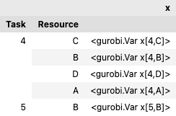
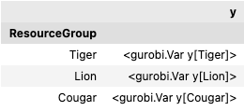
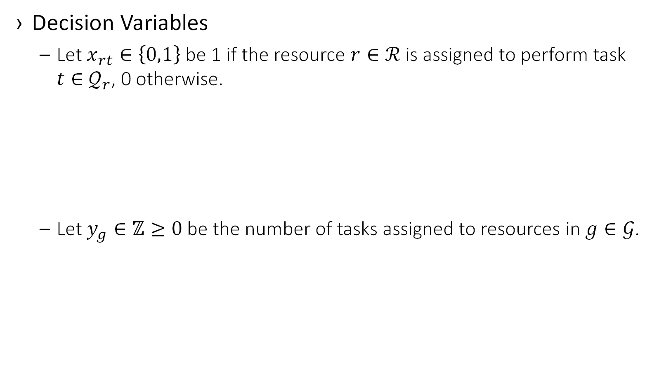
Example – Code Optimization Model
Decision Variables
Let $x_{rt}∈\left\{0,1\right\}$ be 1 if the resource $r∈ℛ$ is assigned to perform task $t∈$ $𝒬_{r}$, 0 otherwise.
Let $y_{g}∈ℤ≥0$ be the number of tasks assigned to resources in $g∈𝒢$.
x = pd.Series(
m.addVars(res_task.index, vtype=grb.GRB.BINARY,
name="x"),
index=res_task.index, name="x”
)
y = pd.Series(
m.addVars(resource_groups.index,
vtype=grb.GRB.INTEGER,
name="y"),
index=resource_groups.index, name="y"
)

Slide 56
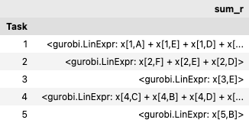
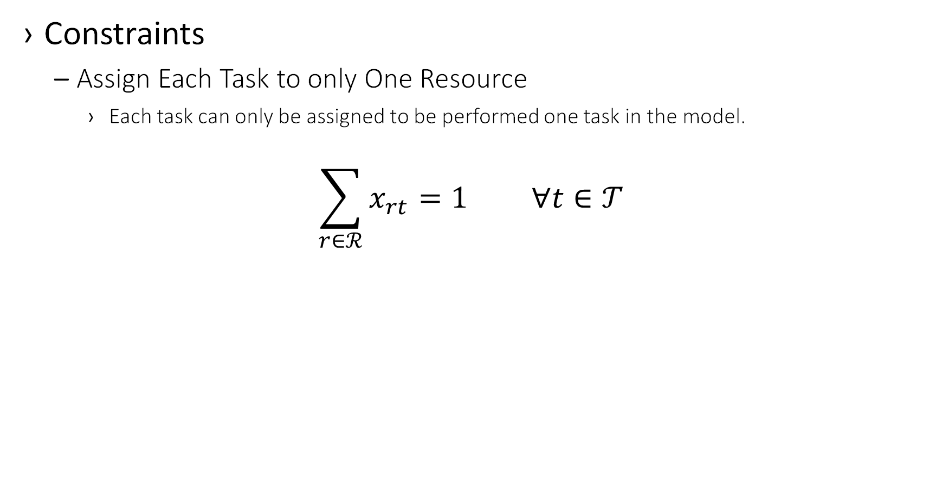
Example – Code Optimization Model
Constraints
Assign Each Task to only One Resource
Each task can only be assigned to be performed one task in the model.
$$\sum_{r∈ℛ}^{​}{x_{rt}}=1 ∀t∈𝒯$$
df = x.groupby('Task').agg(grb.quicksum)
for ind, sum_r in df.items():
m.addConstr(sum_r == 1,
name=namer(
"AllTasksMustBeScheduled",
ind))

Slide 57
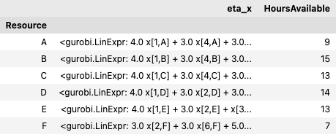
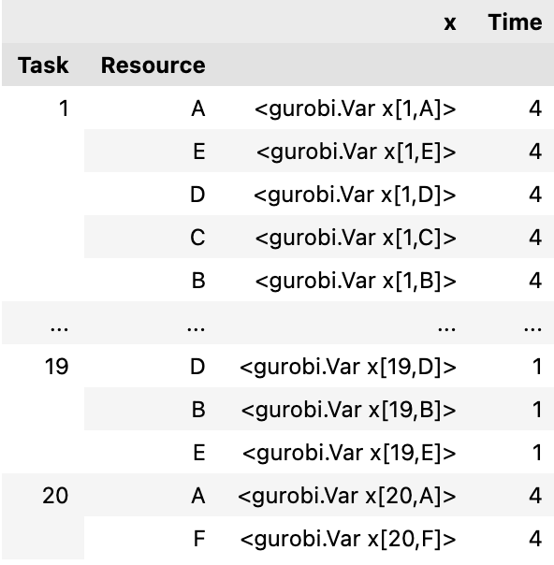
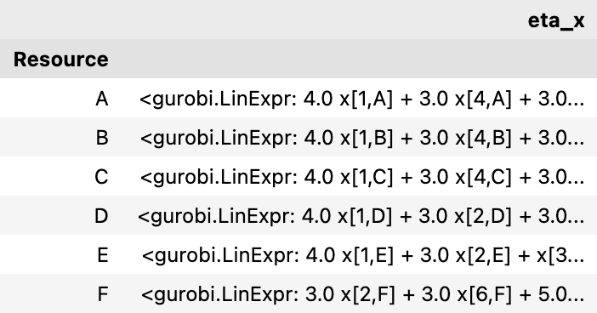
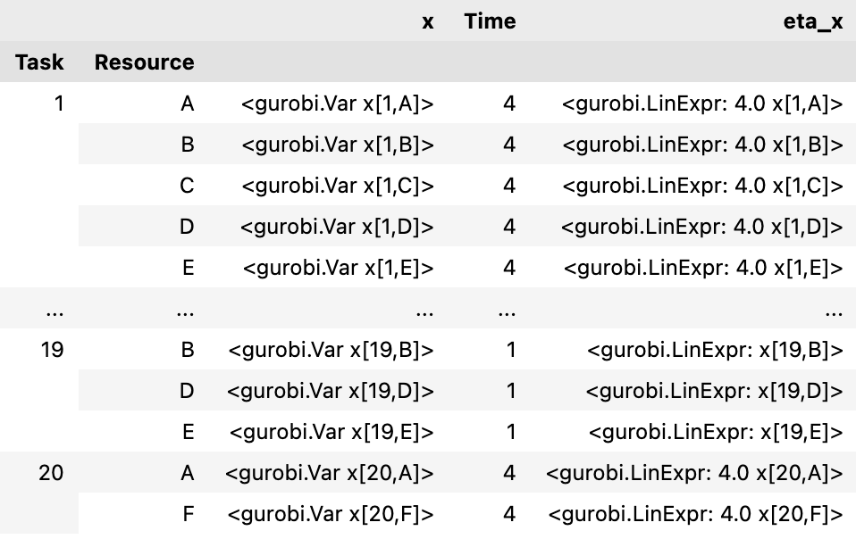
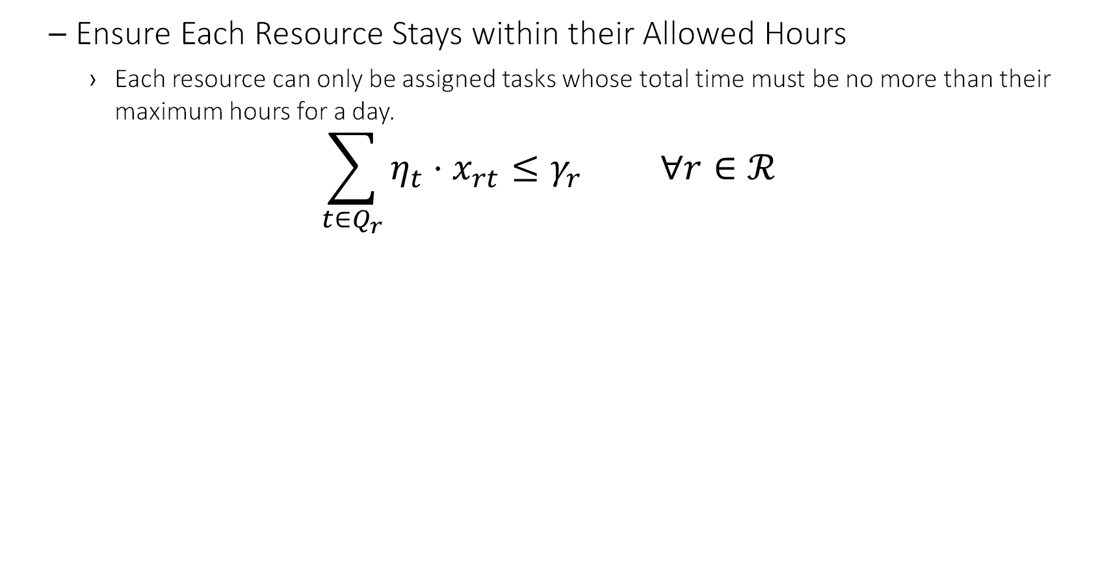
Example – Code Optimization Model
Ensure Each Resource Stays within their Allowed Hours
Each resource can only be assigned tasks whose total time must be no more than their maximum hours for a day.
$$\sum_{t∈Q_{r}}^{​}{η_{t}}⋅x_{rt}≤γ_{r} ∀r∈ℛ$$
df = pd.concat(
[
pd.merge(x, tasks["Time"],
how="left", left_on="Task",
right_index=True)
.assign(eta_x=lambda df:
df["Time"] * df["x"])
.groupby(["Resource"])
["eta_x"]
.agg(grb.quicksum),
resources["HoursAvailable"],
],
axis=1)
for it in df.itertuples():
m.addConstr(
it.eta_x <= it.HoursAvailable,
name=namer("ResourceCantExceedHours",
it.Index))

Slide 58
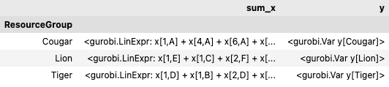
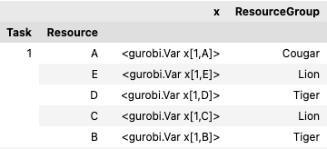
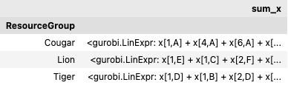
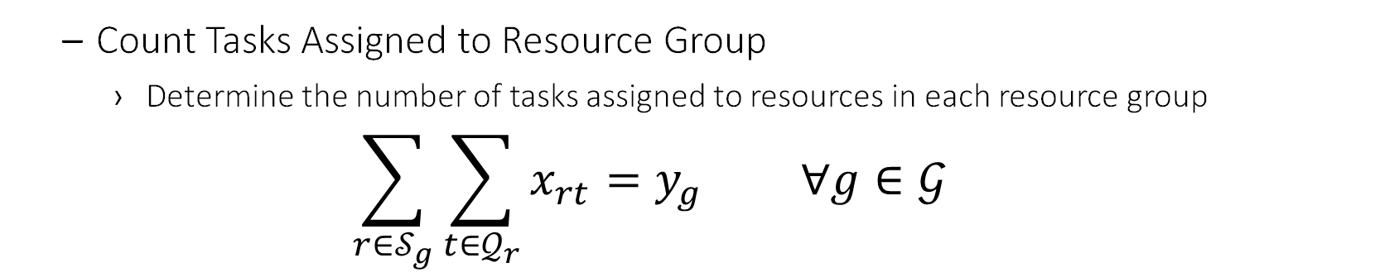
Example – Code Optimization Model
Count Tasks Assigned to Resource Group
Determine the number of tasks assigned to resources in each resource group
$$\sum_{r∈𝒮_{g}}^{​}{\sum_{t∈𝒬_{r}}^{​}{x_{rt}}}=y_{g} ∀g∈𝒢$$
df = pd.concat(
[
pd.merge(x, resources["ResourceGroup"],
how="left",
left_on="Resource",
right_index=True,
)
.groupby("ResourceGroup")["x"]
.agg(sum_x=grb.quicksum),
y,
], axis=1)
for it in df.itertuples():
m.addConstr(it.sum_x == it.y,
name=namer(
"CountTasksForGroup",
it.Index))

Slide 59
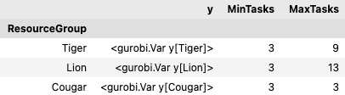
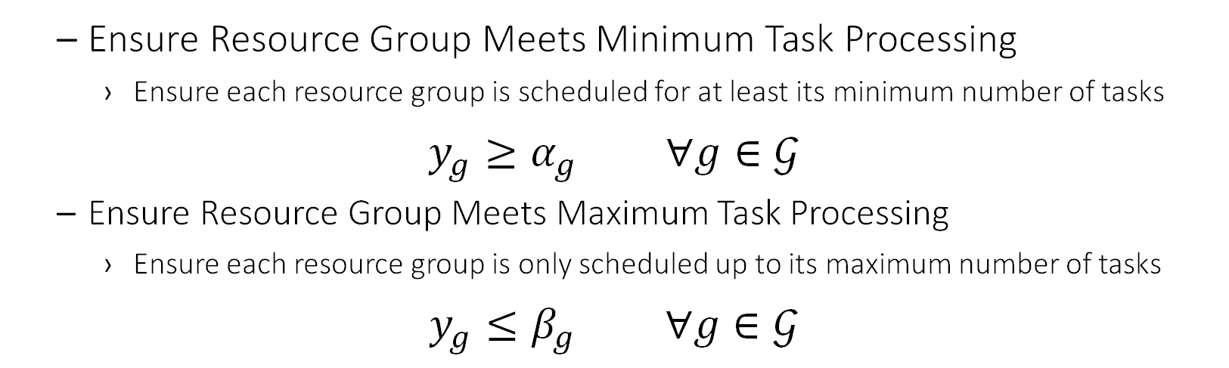
Example – Code Optimization Model
Ensure Resource Group Meets Minimum Task Processing
Ensure each resource group is scheduled for at least its minimum number of tasks
$$y_{g}≥α_{g} ∀g∈𝒢$$
Ensure Resource Group Meets Maximum Task Processing
Ensure each resource group is only scheduled up to its maximum number of tasks
$$y_{g}≤β_{g} ∀g∈𝒢$$
df = pd.concat([y, resource_groups], axis=1)
for it in df.itertuples():
m.addConstr(it.y >= it.MinTasks,
name=namer("GroupMeetsMinTasks",
it.Index))
m.addConstr(it.y <= it.MaxTasks,
name=namer("GroupMeetsMaxTasks", it.Index))

Slide 60
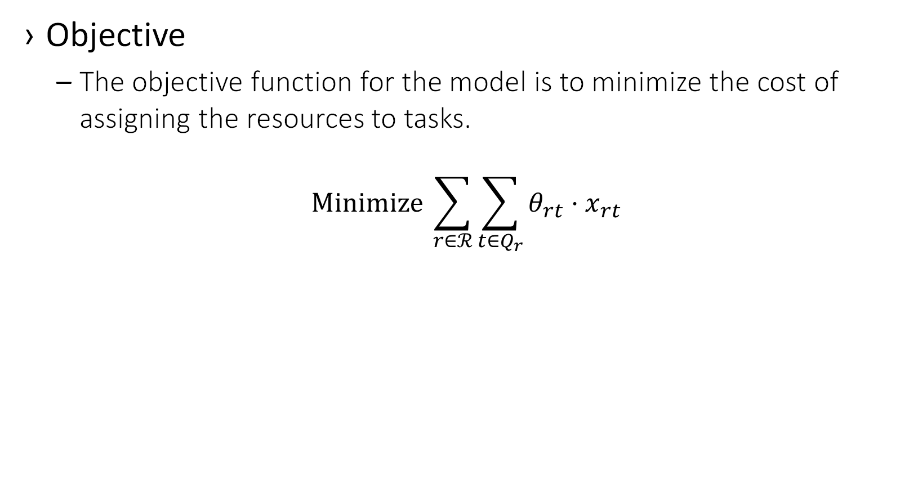
Example – Code Optimization Model
Objective
The objective function for the model is to minimize the cost of assigning the resources to tasks.
$$Minimize \sum_{r∈ℛ}^{​}{\sum_{t∈Q_{r}}^{​}{θ_{rt}}}⋅x_{rt}$$
z = grb.quicksum(theta * x)
m.setObjective(z, grb.GRB.MINIMIZE)

Slide 61
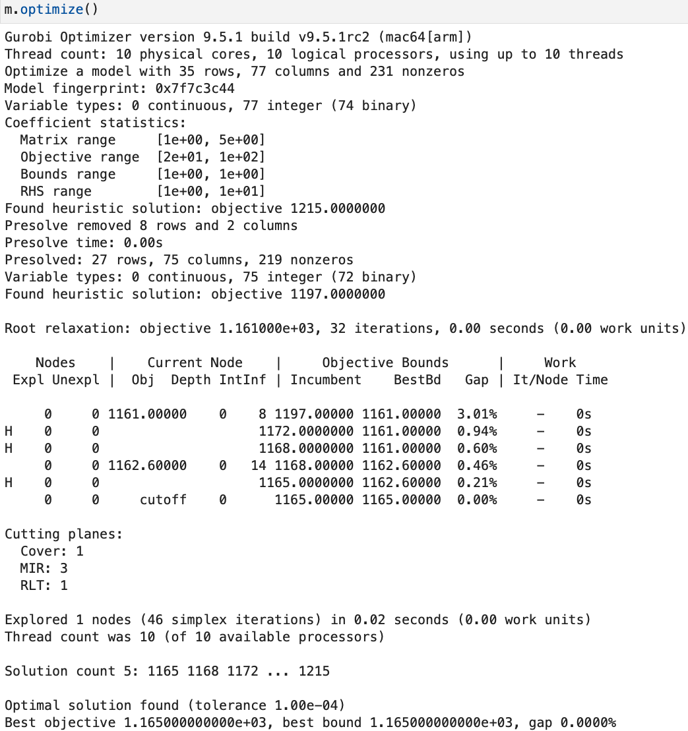
Example – Code Optimization Model
Run the model with Gurobi

Slide 62
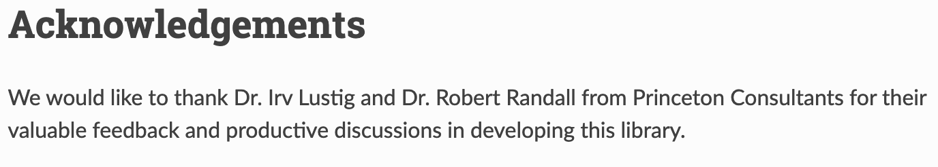
Updates to Gurobi API
Gurobi recently released a new python API for building models called gurobipy-pandas
Irv and I helped test this and provided feedback based on our experience building models using python and Gurobi
To see the implementation of the example model using this library, please checkout the GitHub repo mentioned at the end of the presentation
Can compare the two implementations by reviewing the Jupyter notebooks:
Original gurobipy implementation: Prototype Model.ipynb
New gurobipy-pandas implementation: Prototype Model-gurobipy-pandas.ipynb

Slide 63
1. Understand the Data
2. Define and Document Datasets
3. Collect Data from the Client
4. Document Data Transformations
5. Create Model Documentation
6. Code Optimization Model
7. Validate Results and Iterate

Slide 64
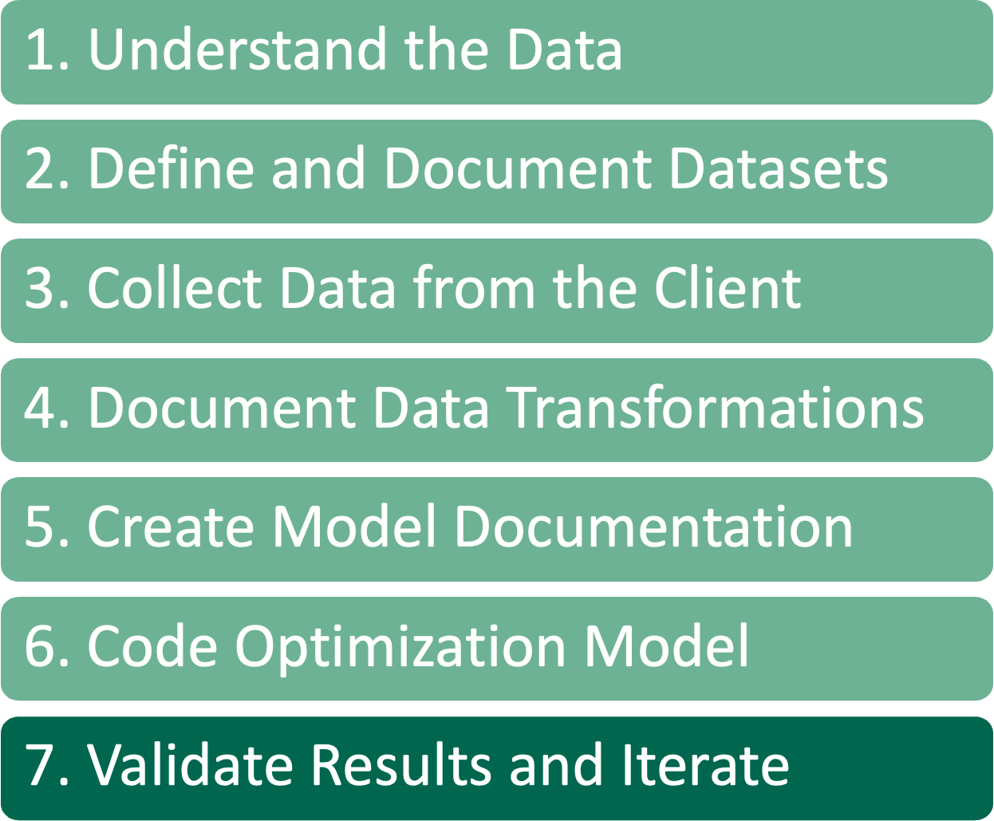


Review Results
For reviewing results, it helps to have a visual representation to enhance our understanding of the results and to review with clients
A tool that we like is plotly
The top plot here shows the assignment of the tasks to resources and how much time each resource is working, with another line for the max time for each resource
Bottom plot shows the resource group usage for tasks with separate lines for the min and max tasks
Don’t be surprised if the client hates the initial results
Most are bad at verbalizing what they really want/need. Therefore, iterating on solutions is very important

Slide 65
Solution Checker
Written by someone other than the modeler
Does not even need to be an optimization person
Model Solution is output as data frames
They can use the same data as input data
Do not copy, or preferably even look at, code written by the modeler
Only use the data and business rules documents should be used
Validates the constraints and value of the objective function

Slide 66
Development Tools
Here are some of the tools that we use, and recommend, for developing models
Anaconda – Package manager that allows for easy environment setup
pandas – Python library for data management
Visual Studio Code – Rich IDE with git (and svn) integration, along with many other extensions
We use pylance type checking as a tool inside Visual Studio Code to evaluate our python code for potential issues
mypy – Type checks code for potential issues
pytest – This is a testing harness in python that is straightforward to set up and create tests
Docstrings – Tool in python that allows for functions to describe their inputs and outputs as well as the intent of the function
Markdown – Used to create data and model documentation
Pandoc – Is used to generate PDF documents from the model documentation markdown
Jupyter – Used to analyze data and create proofs of concept
Solver APIs
gurobipy – Gurobi library for python development
gurobipy-pandas – pandas specific Gurobi library for python model development
docplex – IBM ILOG CPLEX and CPO library for python model development
xpress – FICO Xpress-MP library for python model development
ortools – Google OR-Tools library for python model development

Slide 67
Review
1. Understand the Data
2. Define and Document Datasets
3. Collect Data from the Client
4. Document Data Transformations
5. Create Model Documentation
6. Code Optimization Model
7. Validate Results and Iterate

Slide 68
Technical Deployment Issues

Slide 69








Optimization Solution Analogy
Technical
Side
User Interface
Engine
Data

Slide 70
Optimization Solution Components
Technical
Side
IT System
DBMS
Optimization
Database
Data Transport
Optimization
Model
Optimization
User Interface
Model Diagnostics

Slide 71
IT System and DBMS
Technical
Side
IT System
DBMS
Optimization
Database
IT System + DBMS = “System of Record”
Persistent storage (DBMS)
Contains User Interface for Add/ Edit/ Delete and other data elements
Data Transport
Optimization
Model
Optimization
User Interface
Model Diagnostics

Slide 72
Data Transport
Technical
Side
IT System
DBMS
Optimization
Database
Data Transport
Optimization
Model
Bi-directional data to/from IT system and Model
Pull data from IT System
Performs data transformations
Push solutions to IT System
Services Oriented
Loosely coupled generic transactions
Maximum flexibility
Optimization can be built to interface with an existing IT system. New IT system simply complies with same transactions.
Human readable transactions are ideal (eg JSON)
Optimization
User Interface
Model Diagnostics

Slide 73
Optimization Database
Technical
Side
IT System
DBMS
Optimization
Database
Data Transport
Optimization
Model
Stages the data used by optimization
Includes user data inputs
Provides audit/logging capability
Stores optimization scenarios
Optimization
User Interface
Model Diagnostics

Slide 74
Optimization Model Components
Technical
Side
IT System
DBMS
Optimization
Database
Data Transport
Optimization
Model
Data translation and validator
Objective Function(s)
Rules and Constraints
Algorithms
State
Model Log
Model Commands and Notifications
Solution Checker
Optimization
User Interface
Model Diagnostics

Slide 75
Optimization User Interface
Technical
Side
IT System
DBMS
Optimization
Database
Data Transport
Optimization
Model
Browser-based or rich client communicates with model on a server
Typically built by the Optimization Team as a deliverable of the modeling effort
Reason #1: Deeply integrated into displaying Model Internals at high speed
Reason #2: Users do not distinguish between the “model” and its interface
Optimization
User Interface
Model Diagnostics

Slide 76
Model Diagnostics
Technical
Side
IT System
DBMS
Optimization
Database
Data Transport
Optimization
Model
Input History
Recommendations History
Model State History (snapshots)
User Interface Log (watch user selections)
Optimization
User Interface
Model Diagnostics

Slide 77
Ensuring Adoption

Slide 78
Our Solution is Built: Let’s Give it to the Users!
We solved a Scheduling Problem
We show them these graphs.
What’s Missing?

Slide 79

What’s Missing????
THE SCHEDULE!!

Slide 80
What Happened?
We Listened to the Client
They Told us “Assign Resources to Tasks”
Each Resource Can Work Only So Many Hours in a Day
They Didn’t Tell Us
“We need to know when to do the tasks”
“At any one time, each resource can do at most a certain number of tasks”
“Each task is rounded to 5 minutes in length, not in hours”
Maybe because we only spoke to 2 of the 4 schedulers!
We thought it was a MIP
But now we need to investigate Constraint Programming…..

Slide 81
Issues in Scheduling Problems: Objectives
Tradeoff Issue of Tasks Required vs. Resource Capacity vs. Time
Given a certain resource capacity, how many tasks can you execute in a specified time frame?
Maximize Tasks
Minimize Resources
Minimize Time
How much resource capacity is needed to execute a given set of tasks in a specified time frame?
Given a certain resource capacity, and a set of tasks to execute, what is the shortest schedule that can be created?

Slide 82
Schedule Planning vs. Operational Scheduling
Planning
Schedule tasks
Assign resources
Everything can be Changed
Don’t Worry About the Past – Schedule the Future
Operations
The Resources are Working on Assigned Tasks
Which Tasks and Resources can be Changed by Optimization?
Which future tasks and resource assignments are locked?
Maintain Future Schedule Stability
Minimize Changes to the Planned Schedule
What Events Trigger Changes to the Schedule?
New tasks and resources
Deleted tasks and unavailable resources
New estimates for task duration, or resource requirements

Slide 83

Example Assuming Annual Scheduling: Schedule on Jan. 1

Slide 84

Example Assuming Annual Scheduling: Schedule on July 1
FINISHED
ACTIVE
CAN BE MOVED

Slide 85

Example Assuming Annual Scheduling Schedule on Dec. 5
FINISHED
ACTIVE (Carryover)
To be Scheduled
Next Year’s Tasks

Slide 86
User Adoption for Scheduling
Requires Discussions of the Current Business Processes
Bottom-up versus Top-Down
Cadence of Rescheduling
Which Future Plans Be Changed?
May Require Changes to the Business Processes!
Who Gets Impacted by Changes in the Schedule?
People Under Your Control (E.g. Your Staff)
How easily will they accept changes to the schedule?
People Not Under Your Control (E.g., Your Customers)
How flexible are they in terms of accepting changes? How do you manage expectations?

Slide 87

Ongoing Maintenance And Support
Successful Optimization
“Any decision support system left unattended for six months becomes replaced by a spreadsheet.”
Create feedback loops to measure effectiveness
Check in regularly with the users
Continually recalibrate models and verify assumptions about data

Slide 88

The Solution Development Life Cycle
Business Problem (Question) Framing
Analytic Problem Framing
Data
Methodology (Approach) Selection
Model Building
Deployment
Life Cycle Management
Requires Management Consulting Expertise
INFORMS
Certified
Analytics
Professional
Job Task
Analysis
Requires OR and Software Expertise
Requires OR, Software and Management Consulting Expertise

Slide 89
Resources
Princeton blog post on rapid model development: https://www.princetonoptimization.com/blog/blog/princeton%E2%80%99s-rapid-optimization-model-development-approach-python-and-pandas
Demo code shown in this presentation: https://github.com/rrandall1471/2022-INFORMS-Demo

Slide 90

Questions

